Slide 1
CHAPTER - 3
E-Governance Infrastructure Development
Notes:
Are your classroom colors different than what you see in this template? That’s OK! Click on Design -> Variants (the down arrow) -> Pick the color scheme that works for you!
Feel free to change any “You will…” and “I will…” statements to ensure they align with your classroom procedures and rules!

Slide 2
E-Readiness: Data Systems Infrastructure
The core of e-governance is e-MIS and holds the entire database of any organization.
The data that were managed manually need to be computerized or brought into electronic form which means that the preparedness of computerized database or data warehouse is required.
Data quality and data security are of prime concern here as most of the government infrastructures are not up to the mark in developing countries.
The major question that arises here is “Are all the requisite management information systems, records, databases and work processes in proper place so as to provide the quantity and quality of data to support the move to e-governance?”.
This is the core computerization activity of any government process which may take several years to reach this stage.

Slide 3
E-Readiness: Legal Infrastructure
The manual processes in government are usually obsolete, inefficient and bureaucratic.
Though they have transformed to computerization practices, they continue to have poor and inefficient performance and this is due to lack of administrative reforms and lack of business process reengineering.
They lack requisite legislation and legal infrastructure to enable such reforms or reengineering of the existing business practices, rules and regulations within the government at various levels.
This seems to be emphasised in developing countries while developed countries have been significantly successful in administrative reforms and business reengineering.
The fundamental question that arises here is “ Are the laws and regulations required to permit and support the move towards e- governance initiatives in place?
E.g Digital Signature Act

Slide 4
E-Readiness: Institutional Infrastructure
For any government to implement a successful e-governance project, the required institutional infrastructure must be in place which most of the government lack.
The government body has to establish a separate IT department which basically coordinates with facilitators for e-government projects within the nation.
The IT department works out for the hardware selection and procurement, network or software development and implementation and also the training of staff at various levels of the government.
Many countries still lack the institutional infrastructure.

Slide 5
E-Readiness: Human Infrastructure
Human resource development by training is an essential requirement which comes from well trained manpower both technical and non-technical.
The technical manpower resources are essential for all the phases of e- governance and related information system life cycle comprising systems analysis, design, programming, implementation, operation and documentation.
Both private and government institutions should play a major role in this regard.
Apart from technical human infrastructure, there is a need for the crucial training and orientation of user personnel i.e. government staff in e- governance project.
The government employees and staff who are the stake-holders in all e- government projects as the end users are to be appropriately trained and oriented for change management from a manual government environment to e-governance environment.
Such training will make them competent and capable of handling e- governance projects at operational level

Slide 6
E-Readiness: Technological Infrastructure
Technology is fast changing in ICT domain and there is a rapid obsolescence of software as well as hardware which require great financial support time and again.
Government organizations encounter this situation especially as their procedures to procure hardware or software are very inefficient and slow.
The technological infrastructure in developing countries including computing and telecommunication is absent. As a result software and hardware may not be compatible.
The major reasons are
cost of technology
Adaptability
Obsolescence
This is a serious limitation to e-governance implementation.

Slide 7
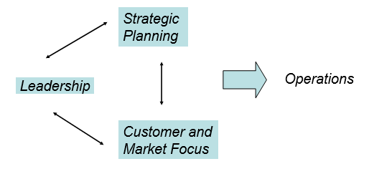
E-Readiness: Leadership and Strategic Planning
Leadership
The ability to positively influence people and systems to have a meaningful impact and achieve results.
Strategic Planning
The process of envisioning an organization’s future and developing the necessary procedures and operations to achieve that future.

Slide 8
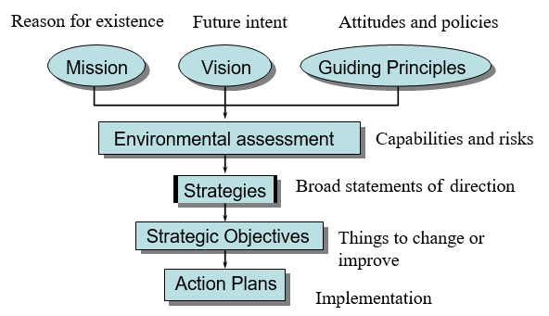
Strategic Planning Process

Slide 9
Leading Practices - Strategic Planning
Active participation of top management, employees, customers, suppliers
Systematic planning systems for strategy development and deployment, including measurement, feedback, and review
Use of a variety of external and internal data
Align short-term action plans with long-term strategic objectives, communicate them, and track progress

Slide 10
Thank you

